Slide 1
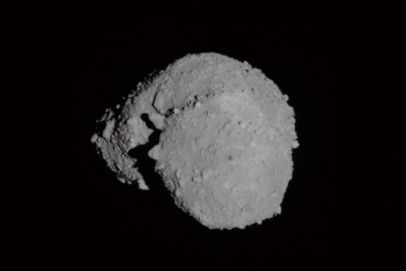

Constraining Composition of Asteroids using Spectroscopy
Adriana Mitchell, Prof. Vishnu Reddy, Allison McGraw (University of Arizona),
Juan Sanchez (Planetary Science Institute)

Slide 2
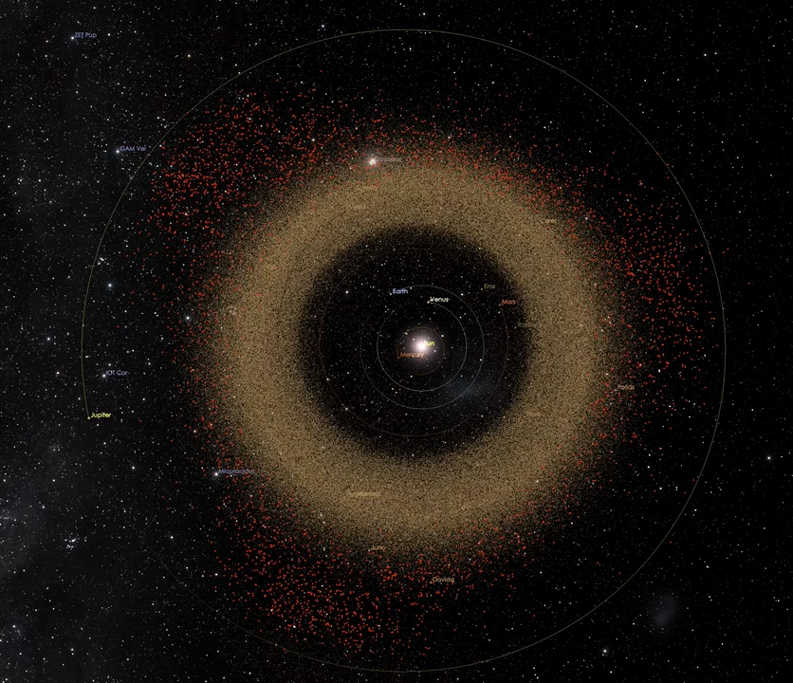
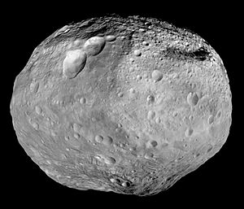
Asteroid Belt
755,000 asteroids
Millions unknown
Largest object: Ceres ~950 km
Largest Asteroid: Vesta ~525 km
Vesta

Slide 3
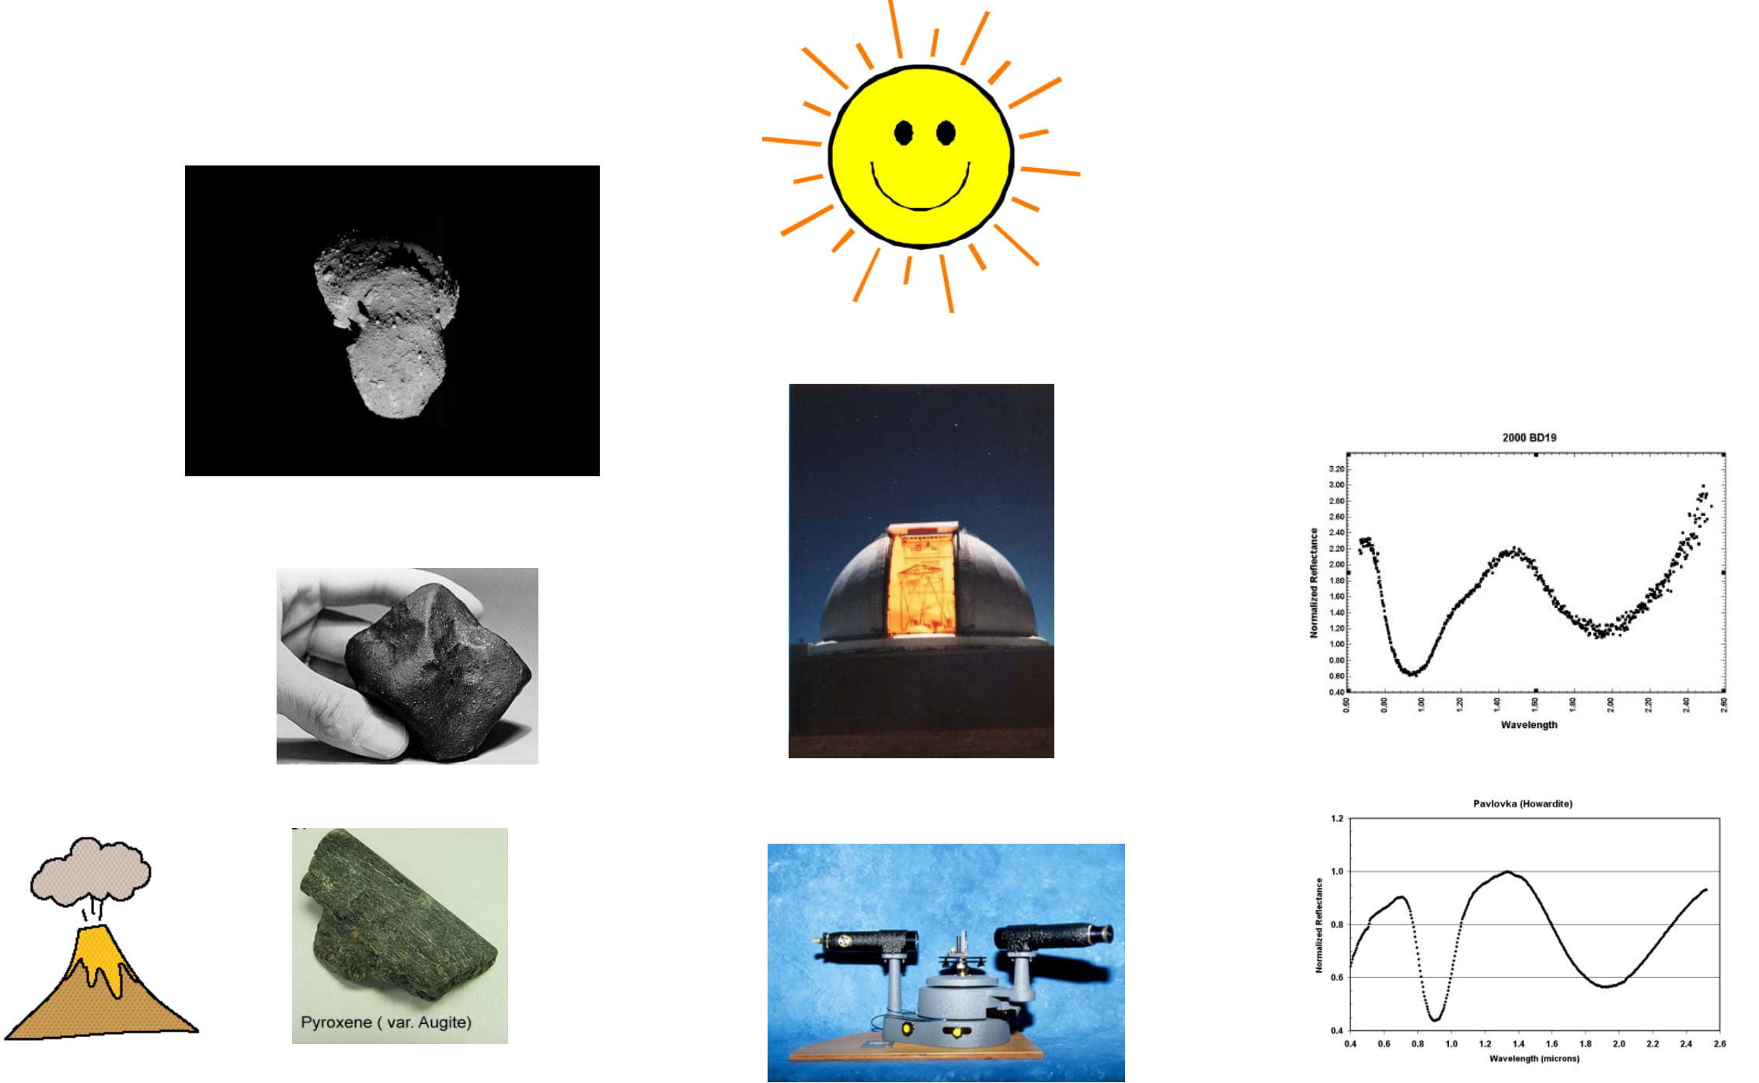
Spectroscopy 101
Asteroids reflect sunlight like all objects in our Solar System
We use a telescope to spread this light to different wavelengths (spectrum)
We can do the same in the lab for meteorites and rocks on Earth
By comparing the lab and telescope spectra we find what asteroids are made of
It is like doing geology but with a telescope
Notes:
Light from the sun hitting asteroids. The light then reflects off of the asteroid and is captured by an observatory on the Earth’s surface. The data produced is called a spectrum. This is a plot of reflected light versus wavelength.
Meteorites fall to Earth and are collected. We use an instrument called a spectrometer to artificially shine light on the meteorites and capture the reflected light, resulting in a spectrum.

Slide 4
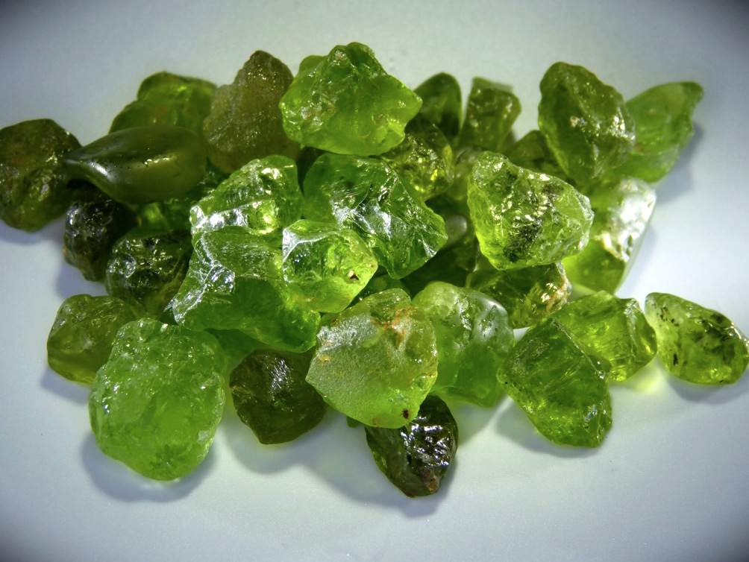
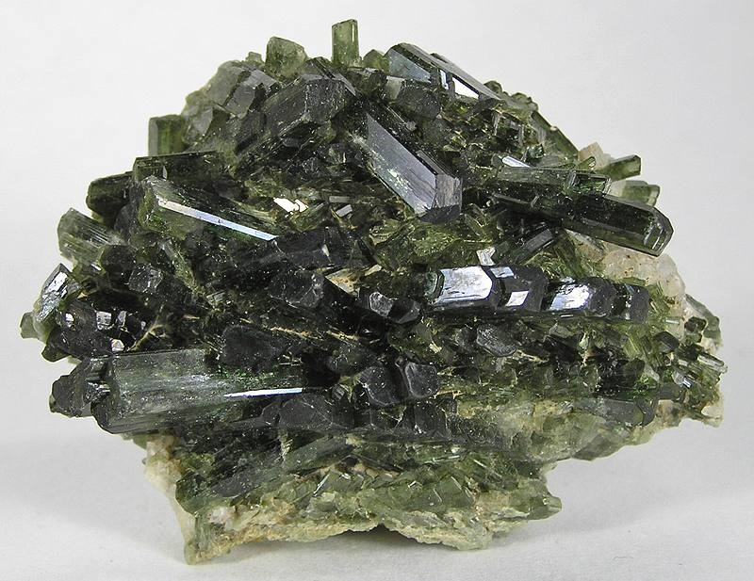
Ordinary Chondrites
86% of all Earth meteorites
S-type asteroids
Three types: H, L, LL
Identifying minerals: Pyroxene, Olivine
Classification Ratio: Olivine/(Olivine + Pyroxene)
LL Chondrite
Olivine
Pyroxene
Notes:
86% of all meteorites that fall on the Earth are ordinary chondrites. (H has more metal). Ratio of Olivine/Pyroxene changes from H>L>LL. Thought to have come from S-type asteroids. Spectroscopically relevant minerals
.

Slide 5
Motivation
Spectra of meteorites are used to understand asteroids
A method to accurately constrain surface composition of S-type asteroids from ordinary chondrites was developed by Tasha Dunn (Dunn et al. 2010).
Her results were not reproducible→ what happened?
Notes:
We tried to duplicate her work in 2017 and we unable to do so. This prompted us to dig deeper into the original calibration. We will present our results of one aspect of this project.

Slide 6
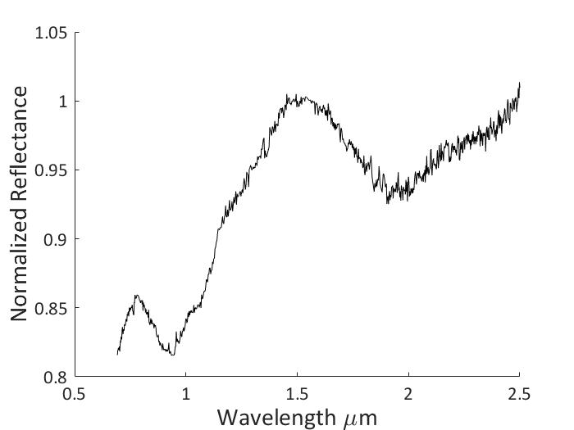
Spectral Properties
BAR = Area of Band II/Area of Band I
Band II
Band II
Band I
Band I
Band centers are diagnostic of iron abundance in the silicate.
Band Area Ratio (BAR) is diagnostic of mineral ratio.
Notes:
For example, band Centers could tell us how much iron is there in the olivine, and BAR could tell us how much olivine is there versus pyroxene.

Slide 7
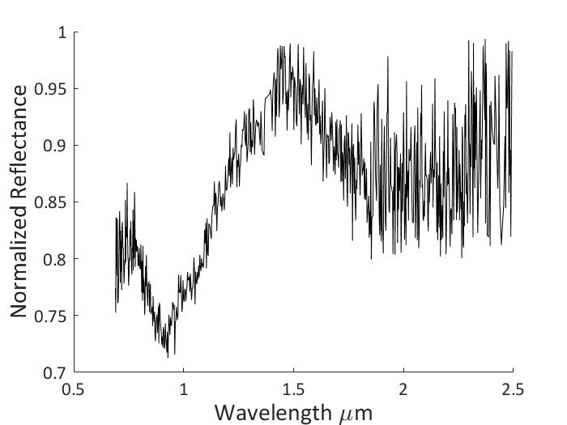
Extracting Band Parameters
Asteroid and meteorite spectra are different
Asteroid spectra are collected with telescopes and so have more noise than lab spectra of meteorites
Clean Meteorite Spectra
Noisy Asteroid Spectra

Slide 8
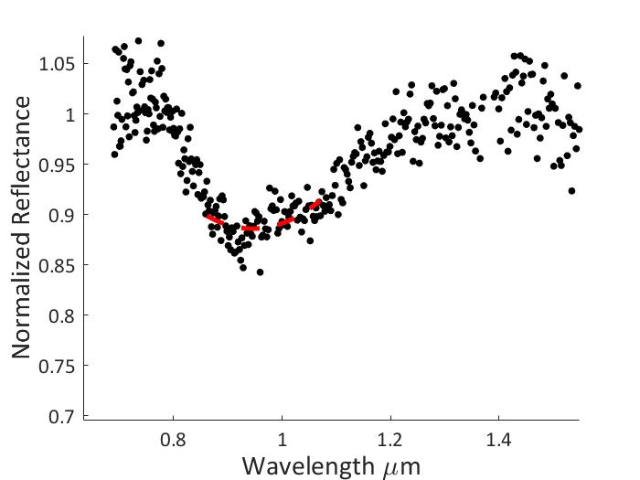
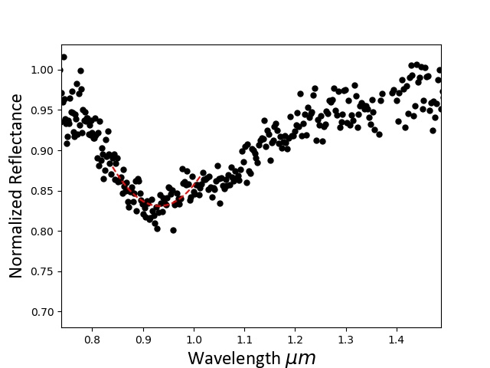
Asteroid Process: Band I
Dunn Method: Automatic
Gaffey Method: Manual
Conclusion: Dunn Method won’t work for asteroid spectra

Slide 9
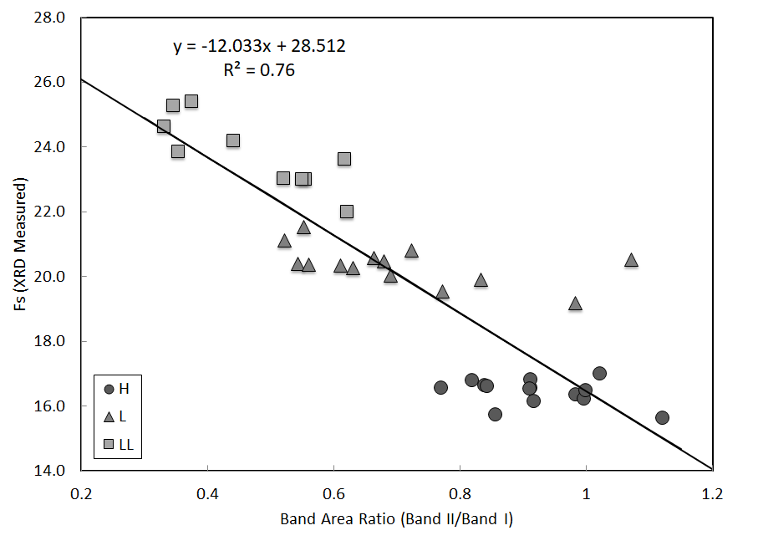
New calibration we developed
We developed a new method for extracting band parameters and constraining composition of asteroids that is more robust than Dunn

Slide 10
Conclusions
Just because something works in the lab doesn’t mean it will work in real world
Lab spectra and asteroid spectra have different amounts of noise and need to be processed differently
Our new method can reliably extract mineralogical composition from asteroid spectra
Currently working on a peer-reviewed paper that will be submitted this summer.
Notes:
Just because something works in the lab doesn’t mean it will work in real world. Lab spectra and asteroid spectra have different amounts of noise and hence need to be processed differently. Our new method can reliably extract mineralogical composition from asteroid spectra. Currently working on a peer-reviewed paper that will be submitted this summer.

Slide 11
Thank you
Space Grant Consortium for funding part of this work.
NASA Near-Earth Object Observation (NEOO) program supported parts of this research (PI: Vishnu Reddy)

